Slide 1

Python Project for Data Analysis Sales Analysis

Slide 2
Analytical Summary
Performed data cleaning and manipulation
Performed exploratory data analysis (EDA) using pandas, matplotlib and seaborn libraries
Improved customer experience by identifying potential customers across different states, occupation, gender and age groups
Improved sales by identifying most selling product categories and products, which can help to plan inventory and hence meet the demands

Slide 3




Project Learnings
01
02
03
04
Data Cleaning
EDA
(Exploratory Analysis)
Customer Insights
Sales Optimization

Slide 4
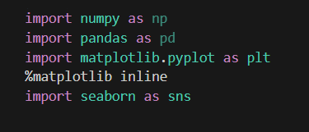
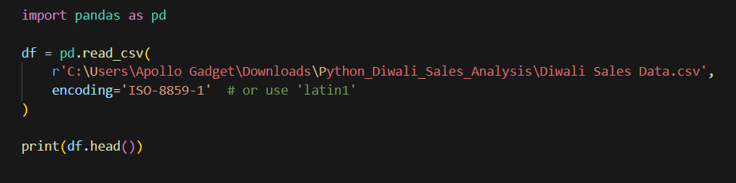
Importing Essential Python Libraries And csv File

Slide 5
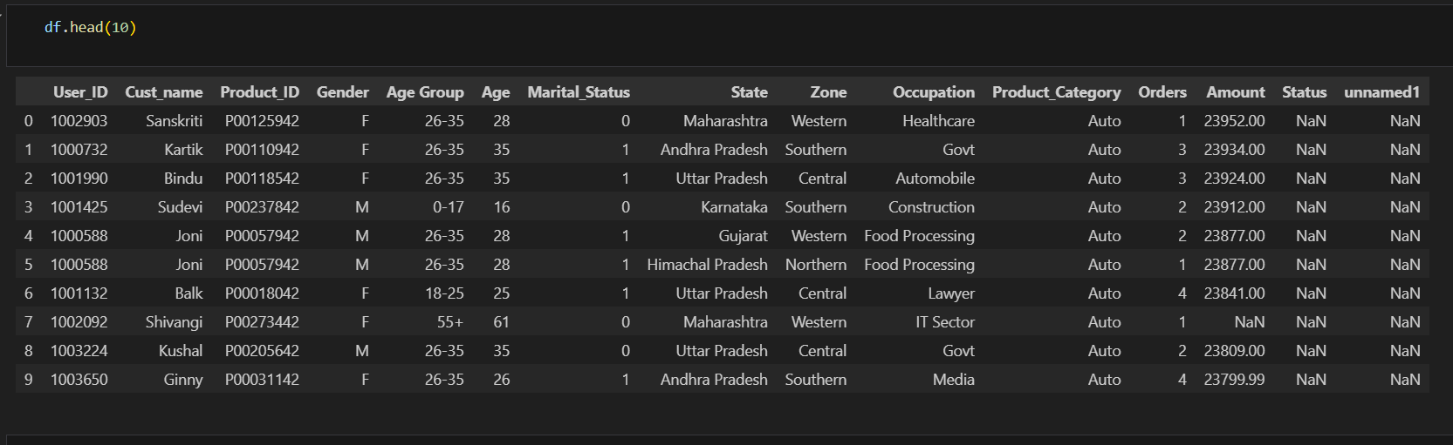
Data Set

Slide 6
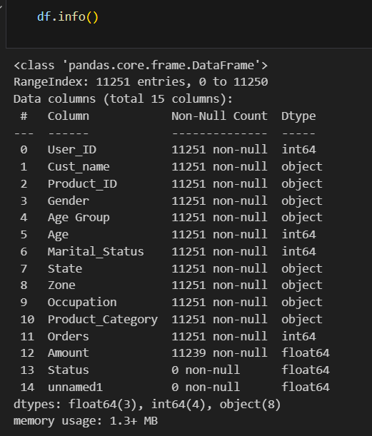
Data Type

Slide 7
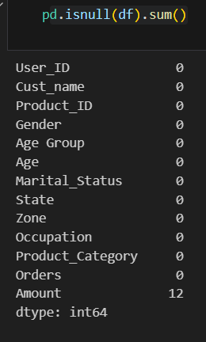
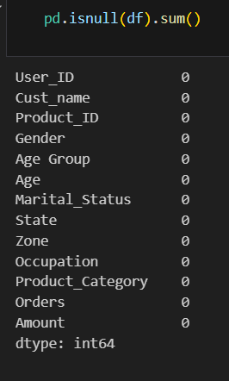

Removing Null Values
A total of 12 null entries were identified in the 'amount' field
After removing the null values

Slide 8
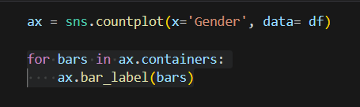
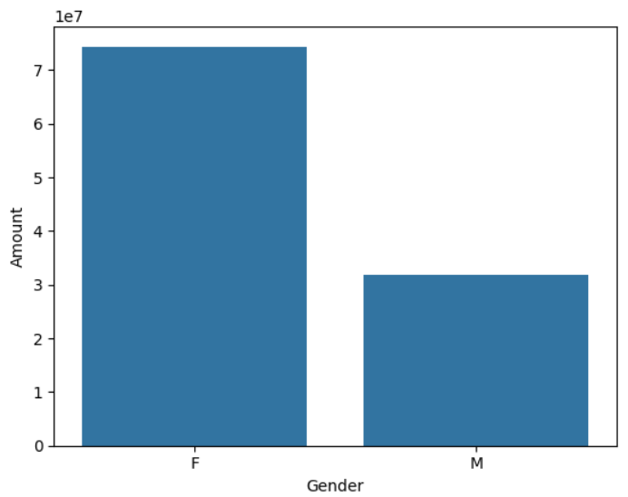
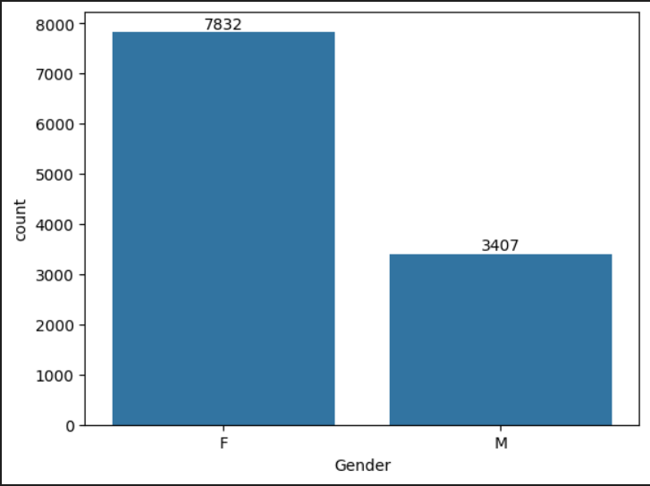
Analyzing Gender-Based Shopping Patterns
#Analysis indicates that women placed more orders and spent more overall than men.

Slide 9
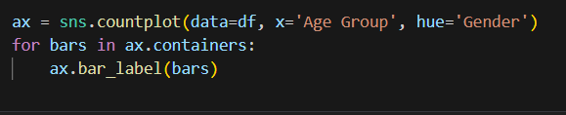
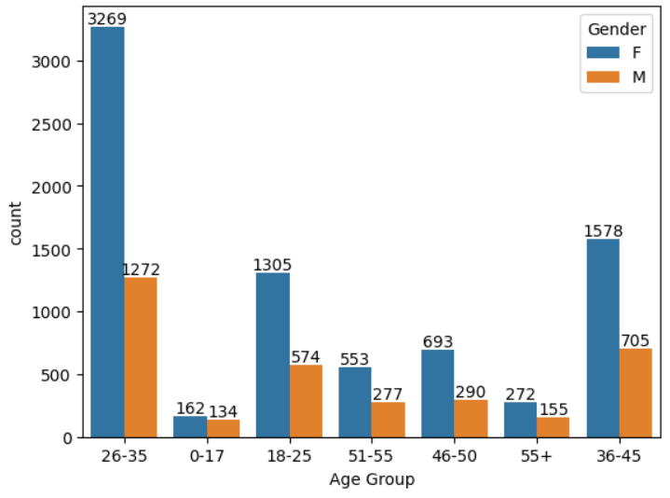
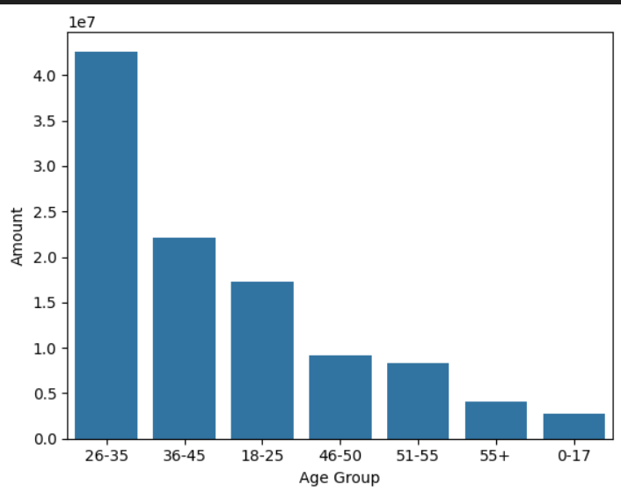
Identifying The Most Active Age Group In Shopping Behavior
#Customers aged 26–35 emerged as the most active demographic, both in terms of order volume and total expenditure.

Slide 10
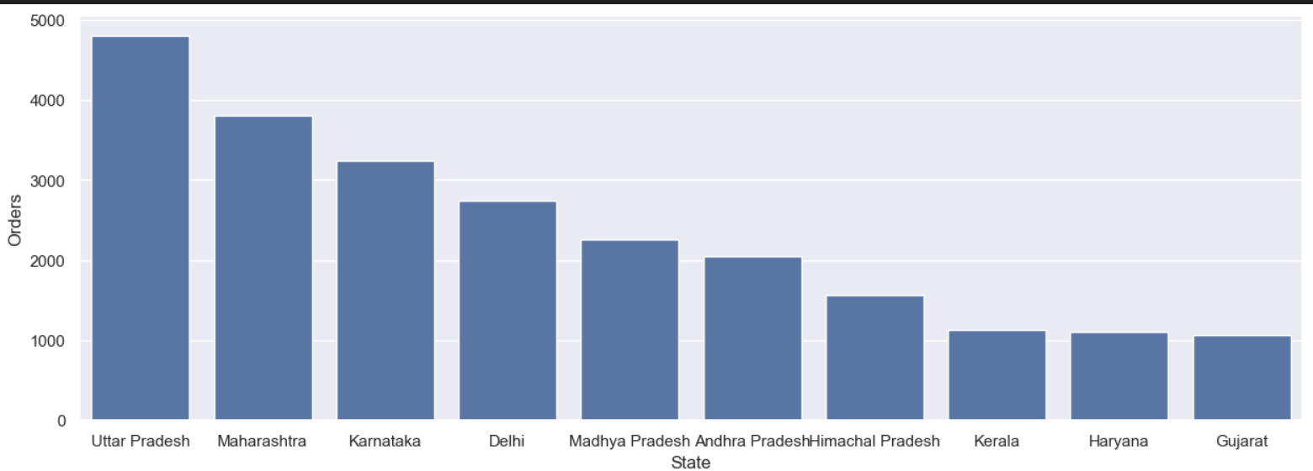
Identifying The State With The Highest Sales Contribution
# Uttar Pradesh recorded the highest sales among all states, indicating strong market performance in the region.

Slide 11
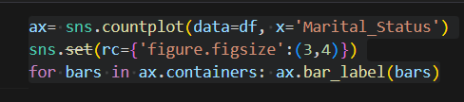
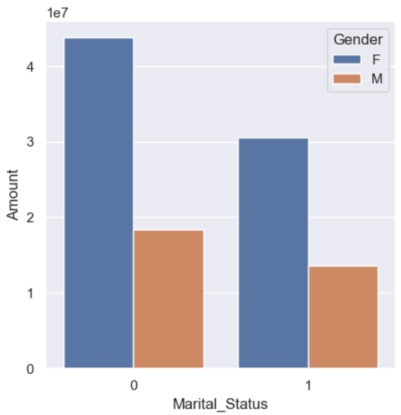
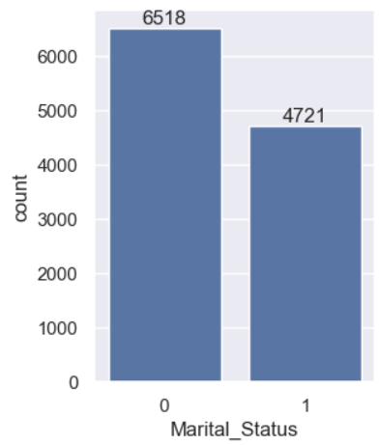
Assessing Sales Distribution By Marital Status
#Analysis reveals that unmarried customers lead in both shopping frequency and total expenditure.

Slide 12
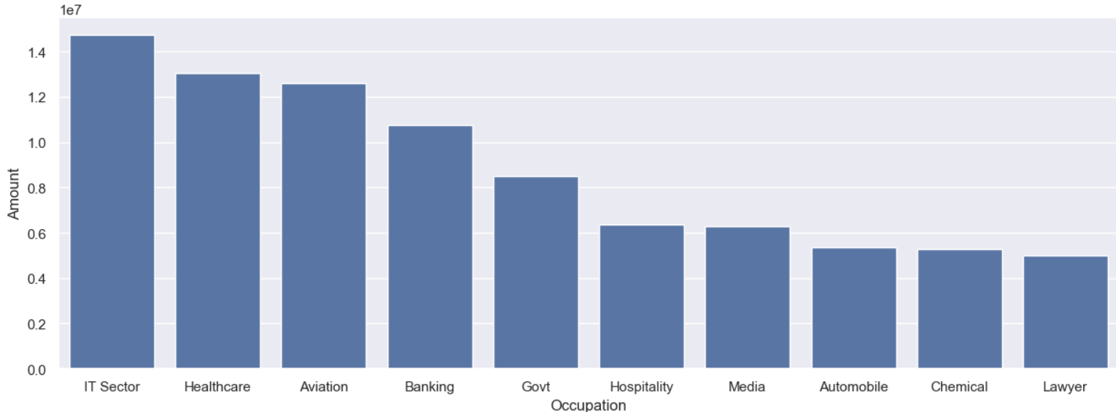
Occupation-based Segmentation Of Consumer Activity
#Customer segmentation analysis reveals that individuals from the IT industry represent the largest share of the user base.

Slide 13
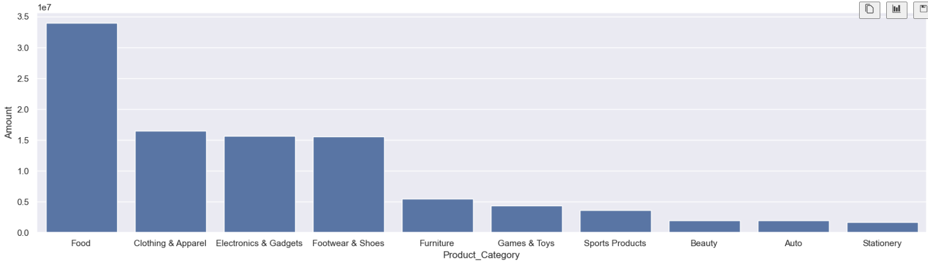
Evaluating Revenue Contribution Across Product Categories
#The food category generated the highest revenue among all product segments.

Slide 14
Thank You

